Slide 1
A Detailed Look in to Belarus Car Market
By : Team Pattern 6
Kartik Jain
Aashish Kumar
Aihan Liu
Ali Can Mutlu
Kurtis Shen

Slide 2
Agenda
Introducing the Topic
Exploratory Data Analysis
Showcasing the Graphs
Evaluation
Questions

Slide 3
Research Proposal
What factors determine the prices of cars in the second hand car market?
Color?
Engine Capacity?
Odometer Value?
Engine Type?
Year Produce?

Slide 4
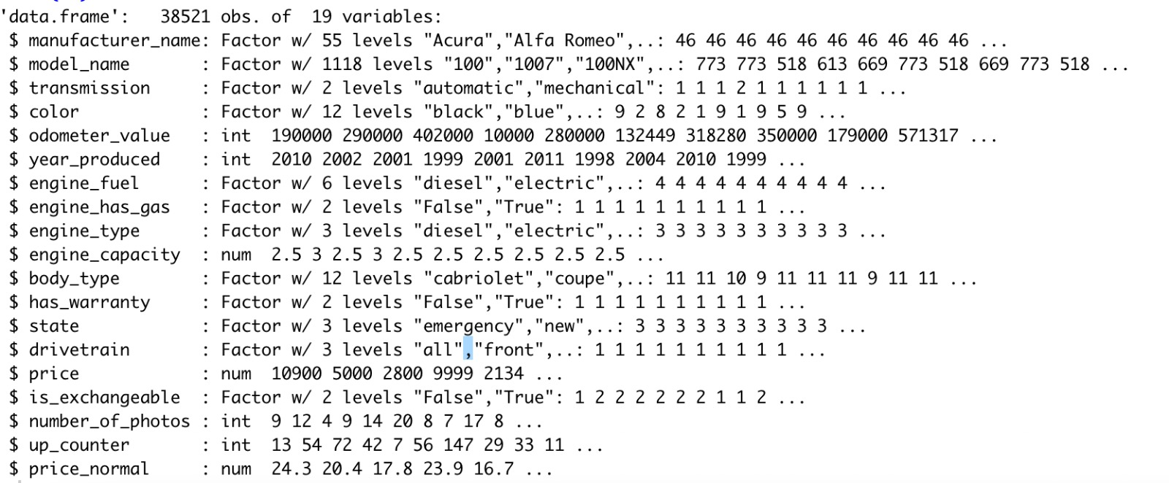
Data Set Information
Used car catalog for Belarus for the year 2019
Source: Kaggle
No. Observations: 38521
No. of variables: 19
MeanPrice: 6639.97$
Std.DevPrice=6428.15$

Slide 5
Step by Step Code – Will Delete
Importing Data
Renaming Features
Checking for Null Values
Summary of Data-Set
Descriptive Statistics
Ggplot – Has_Warranty vs Price
T-test Statistical Significance Test
Ggplot – Engine_type vs Price
T-Test for Diesel vs Gasoline
Test of Independence and Homogenity

Slide 6
Exploratory Data Analysis

Slide 7
EDA preparation
Dropping Null Values : engine_capacity(10)
Converting Variables to Numerical (ask the group)
Name Change: Price USD – Price

Slide 8
Exploring the Graphs

Slide 9
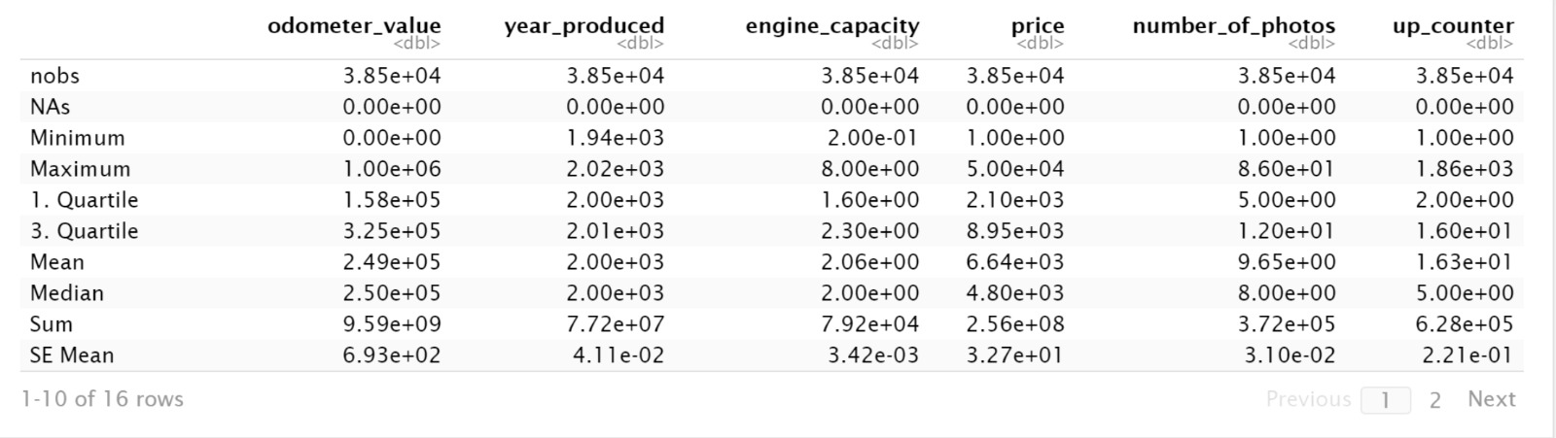
Descriptive – Basic Statistics for the Variables

Slide 10
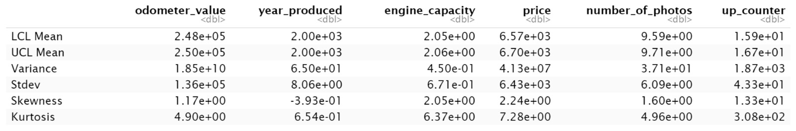
Descriptive – Basic Statistics for the Variables

Slide 11
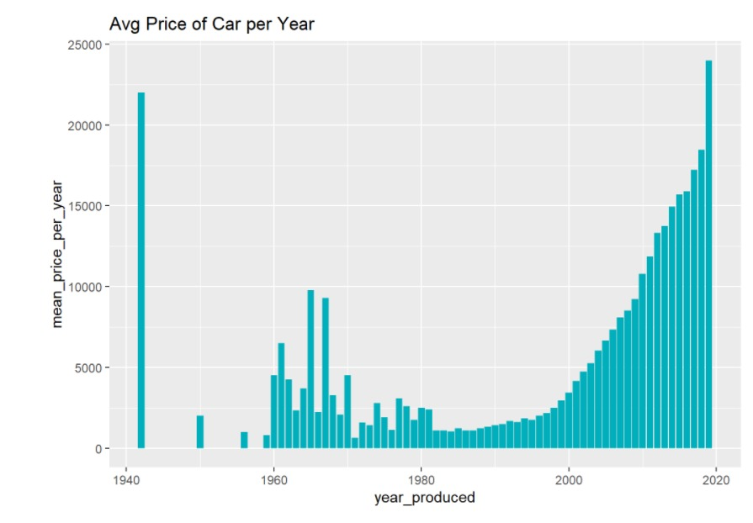

Average Price per Car vs Year Made – Do you see pattern?

Slide 12
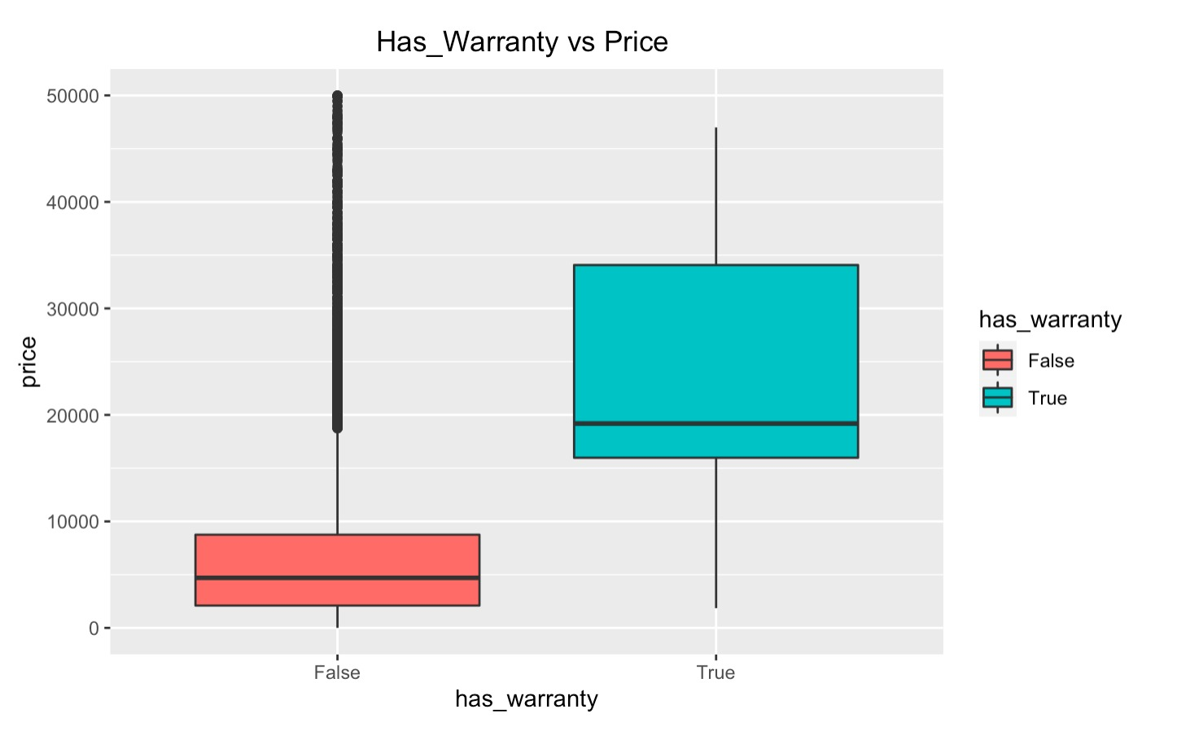
Has_Warranty vs Price – Graph Type: GG-plot

Slide 13
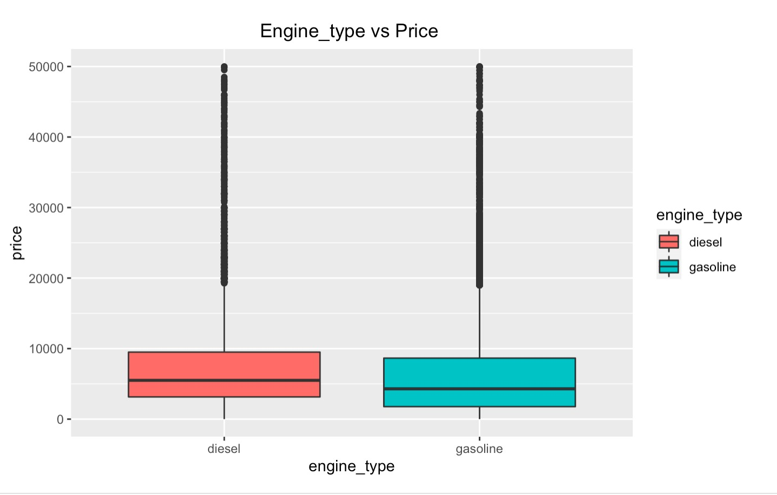
Engine_Type vs Price - GraphType: GG-plot

Slide 14
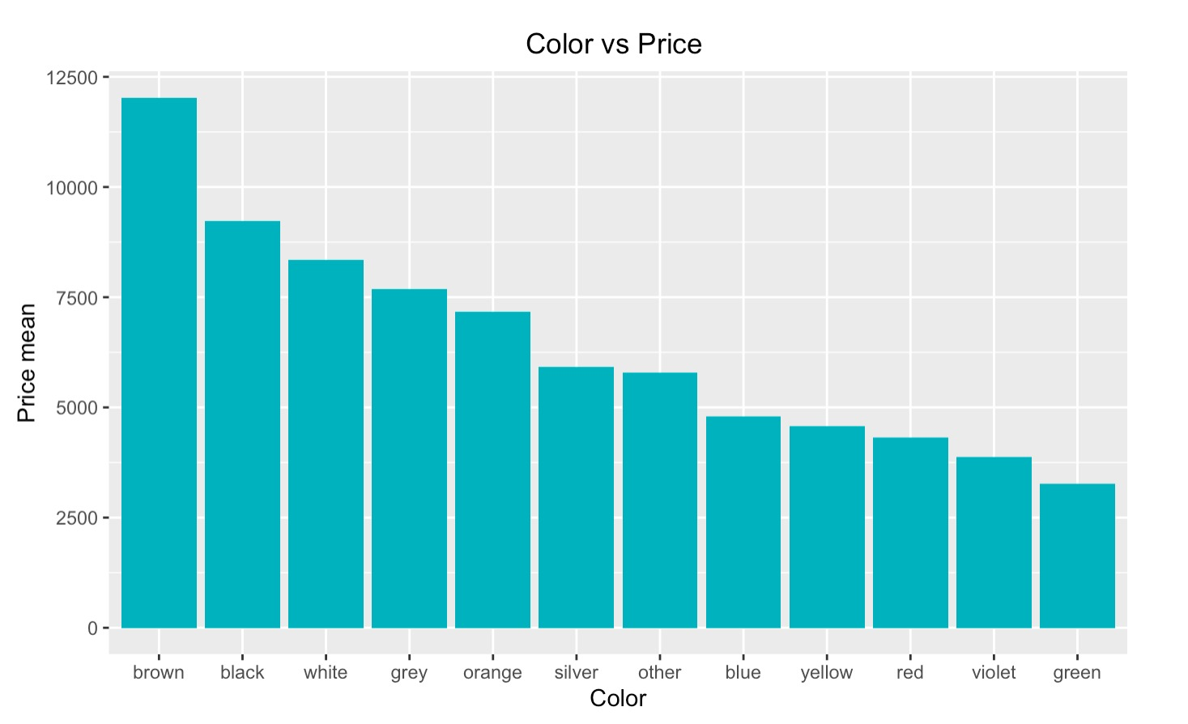
Color vs Price – Graph Type: Histogram

Slide 15
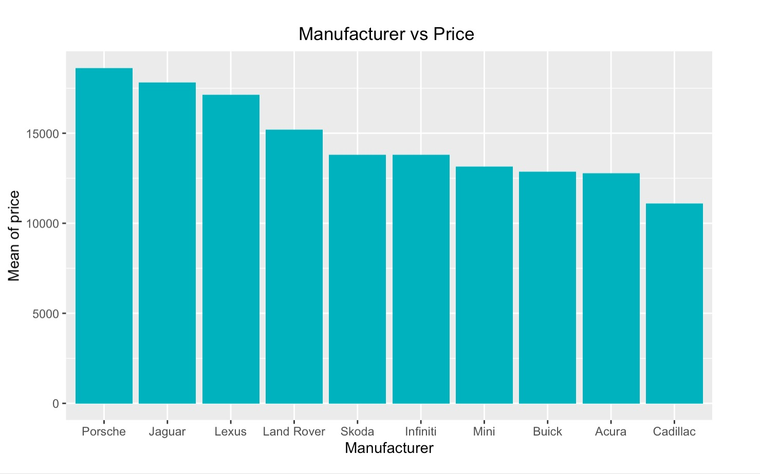
Manufacturer vs Price – Graph Type: Histogram

Slide 16
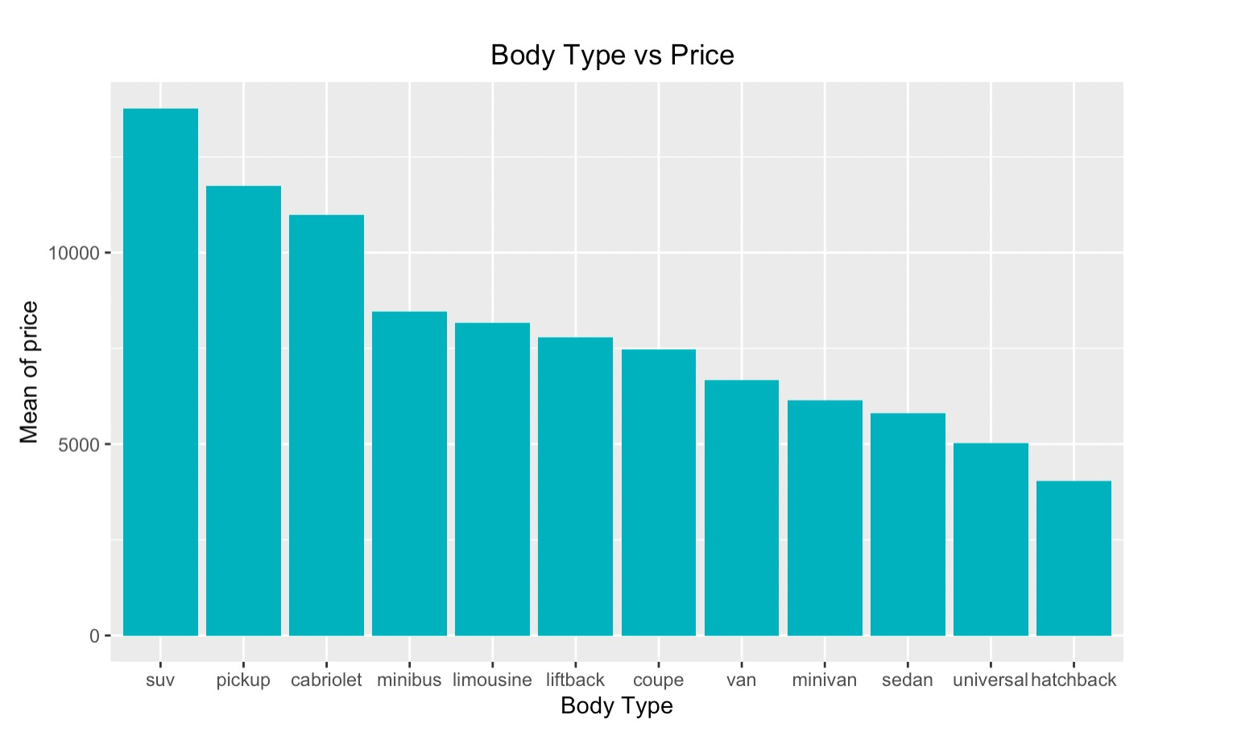
Body Type vs Price

Slide 17
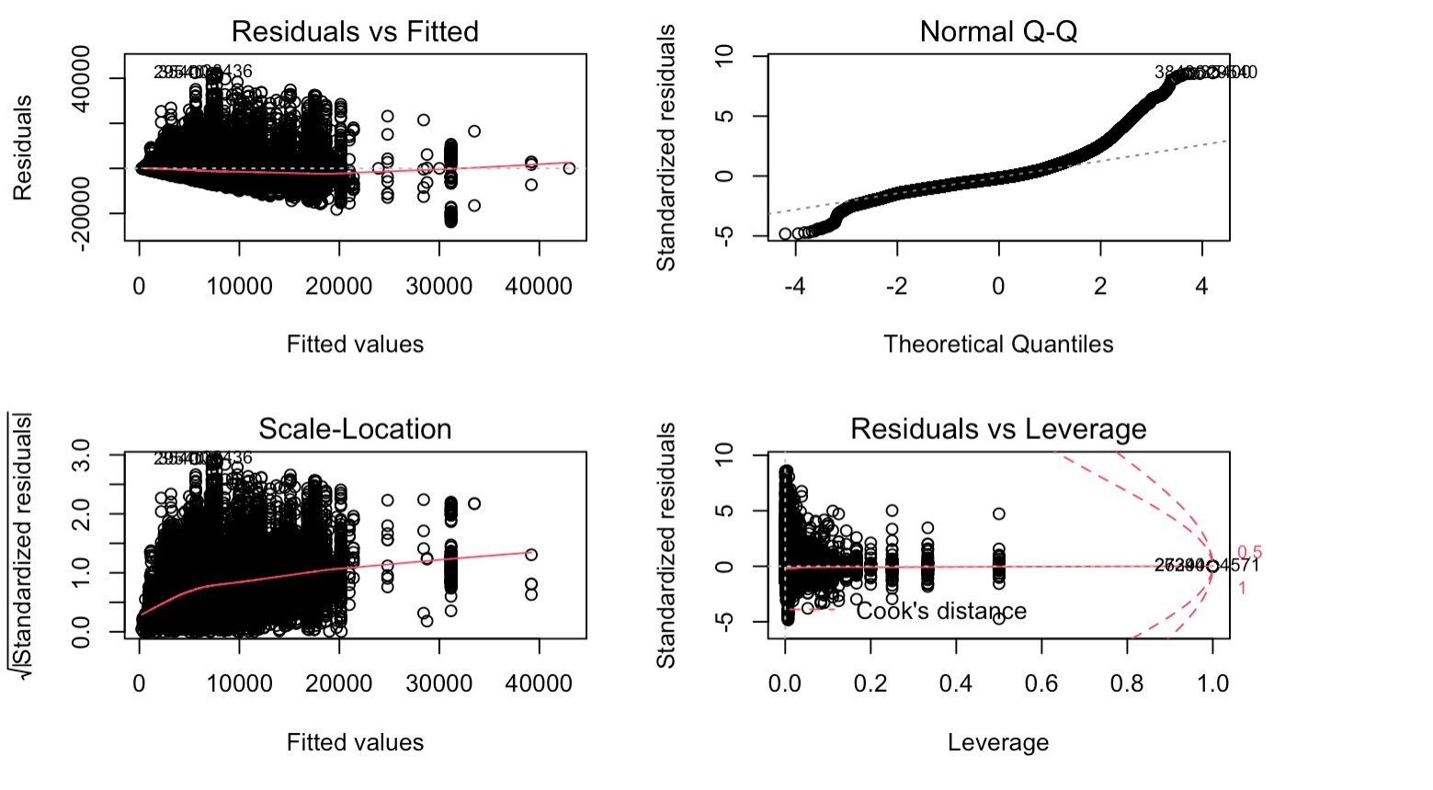
Price vs Color - GphType: ANOVA – One way

Slide 18
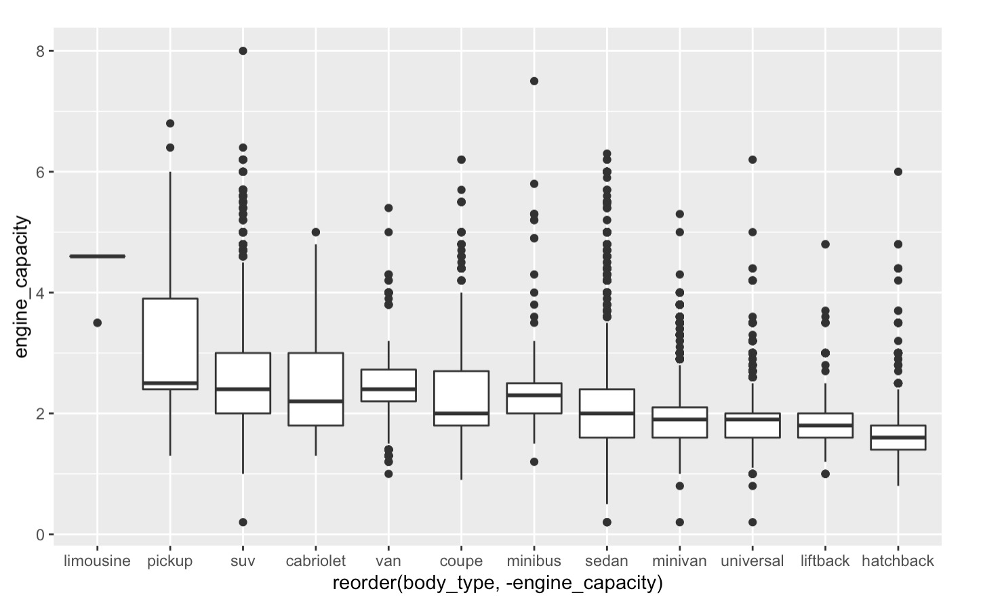
Engine Capacity vs Body Type - GphType: GG-plot

Slide 19
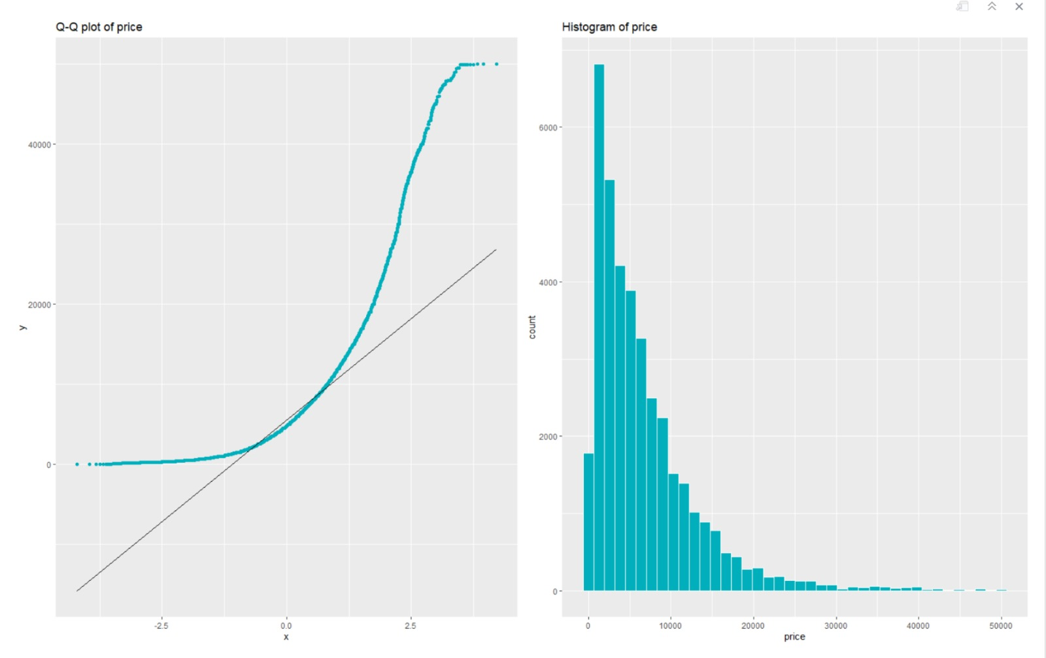
Q-Q Normalization

Slide 20
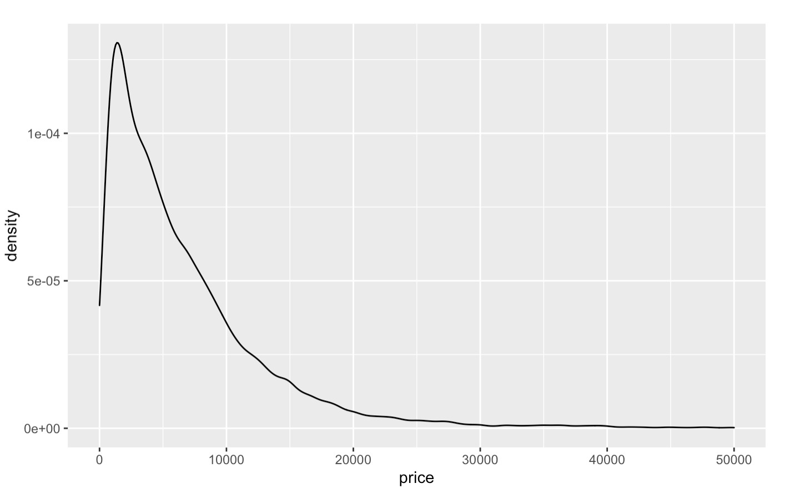
Price Plot - GphType: Density

Slide 21
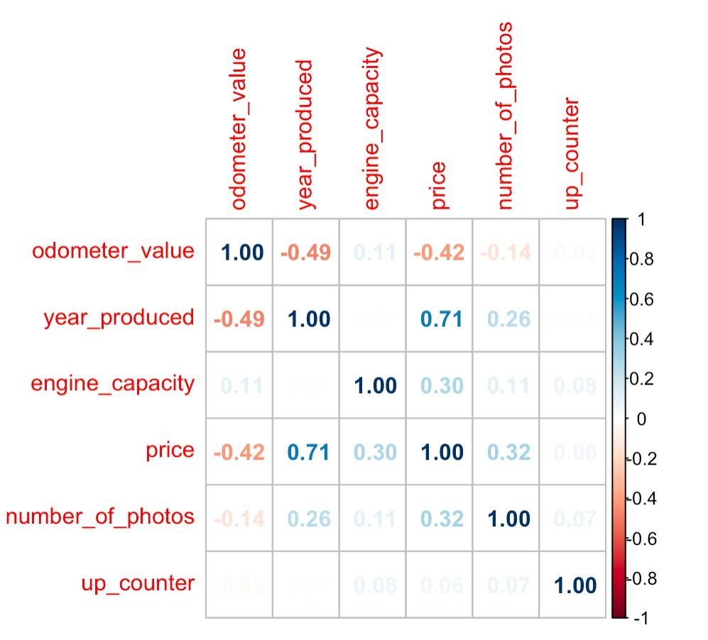
Correlation Plot

Slide 22
Code Part to be Included

Slide 23
ANOVA

Slide 24
Model Building

Slide 25
Model Building
dasdasdsa

Slide 26
Model Building

Slide 27
Model Building

